Slide 1
Software Engineering and
Best Practices

Slide 2
Fundamental Terms / Concepts
Science and Engineering
  Discover
    Relationships that exist but are not found
    Formulas; chemical composition, d=r*t; calories in fats, carbohydrates, proteins; experimentation;
    Astrophysics – origins of the universe
  Build
    Apply principles of science and mathematics to real needs, commodities, structures, products, etc.
Software Engineering; Software Development

Slide 3
Fundamental Concepts
Software Engineering; Software Development
Job positions:
  Software developer
  Programmer
  Software engineer
  Analyst / Programmer
  Senior … what have you…

Slide 4
What is Software Engineering?
The process of solving customers’ problems by the systematic development and evolution of large, high-quality software systems within cost, time and other constraints
Note:
  Process, systematic (not ad hoc), evolutionary…
  Constraints: high quality, cost, time, meets user requirements

Slide 5
Analysis of the Definition:
Systematic development and evolution
  An engineering process involves applying well understood techniques in a organized and disciplined way
Large, high quality software systems
  Software engineering techniques are needed because large systems cannot be completely understood by one person
Cost, time and other constraints
  Finite resources
  The benefit must outweigh the cost

Slide 6
Best Practices of Software Engineering
Develop Iteratively
Use
Component
Architectures
Manage
Requirements
Model
Visually
Verify
Quality
Control Changes

Slide 7
Practice 1: Develop Software Iteratively
Until recently, developed under assumption - most requirements can be identified up front.
The research deconstructing this myth includes work by Capers Jones. (See next slide) In this very large study of 6,700 projects, creeping requirements — those not anticipated near the start—are a very significant fact of software development life, ranging from around 25% on average projects up to 50% on larger ones.

Slide 8
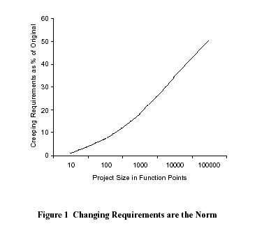
➔ Look up a definition of ‘Function Points.’

Slide 9
Interestingly,
An initial design will likely be flawed with respect to its key requirements. Requirements rarely fully known up front!
Late-phase discovery of design defects results in costly over-runs and/or project cancellation
  Oftentimes requirements change – even during implementation!
While large projects are more prone to cost overruns, medium-size/small projects are vulnerable to cancellation.
The key reasons continue to be
  poor project planning and management,
  shortage of technical and project management expertise,
  lack of technology infrastructure,
  disinterested senior management, and
  inappropriate project teams.”

Slide 10
Waterfall Delays Risks
R
I
S
K
Requirements
Design
Code
Waterfall risk
Integration
System
Test
T I M E

Slide 11
Iterative Development
Iteration 1
Iteration 2
Iteration 3
➔ Earliest iterations address greatest risks
Each iteration produces an executable release
Each iteration includes integration, test, and assessment!
Objective Milestones: short-term focus; short term successes!

Slide 12
Accelerate Risk Reduction
Walker Royce, 1995
R
I
S
K
Risk reduction
Waterfall risk
Iterative
Iteration
Iteration
Iteration
Iteration
Iteration
T I M E

Slide 13
Summary
Much more about iteration and iteration planning later
You will see some of these again – and, more importantly, use this information in your own iteration planning.

Slide 14
TEXT BOOKS
1. Richard Fairley, “Software Engineering Concepts”, Tata McGraw Hill, 1997.
2. Roger S. Pressman, “Software Engineering - A Practitioner’s Approach”,6th Ed., McGraw Hill International, 2005.
Books for reference
1. Ian Sommerville, “Software Engineering”, Addition Wesely, Singapore,2002
2. K.K.Agarwal&Yogesh Singh, “Software Engineering”, New Age Intl.Publishers, Revised 2nd Ed., 2005.

Slide 15
THANK YOU

